Slide 1
Car Rental Data Quality - Categorical
08-14-22

Slide 2
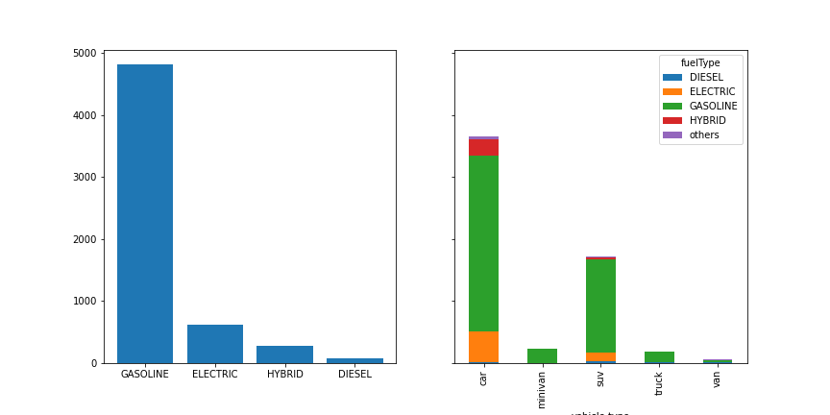
fuelType & by vehicle.type

Slide 3
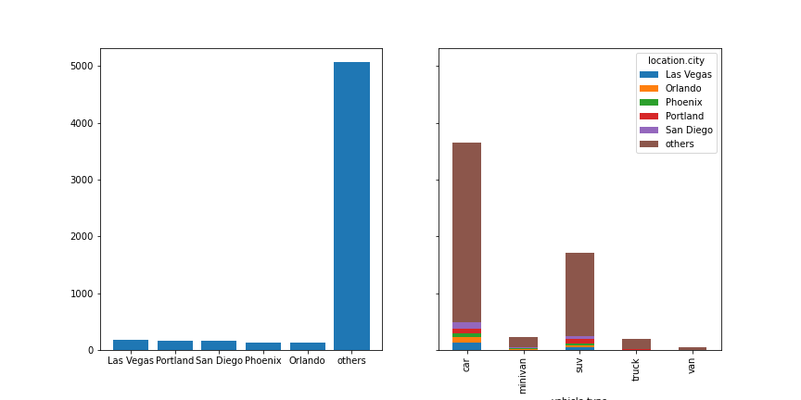
location.city & by vehicle.type

Slide 4
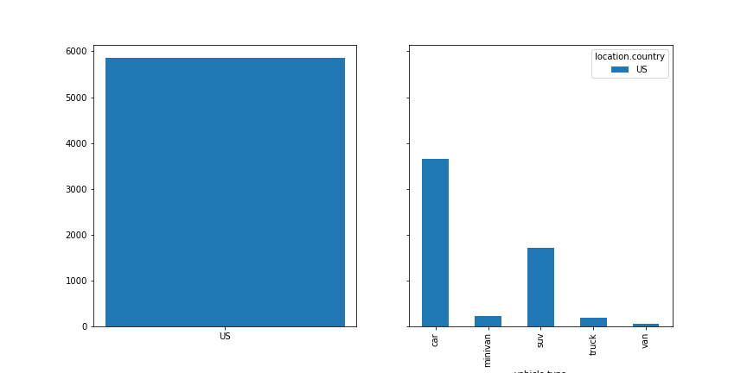
location.country & by vehicle.type

Slide 5
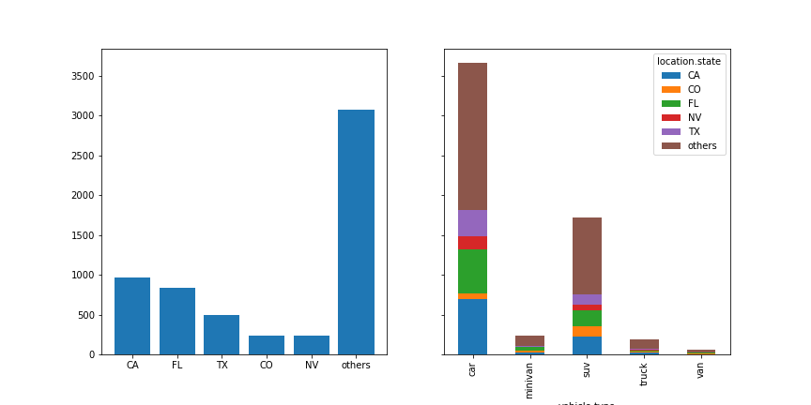
location.state & by vehicle.type

Slide 6
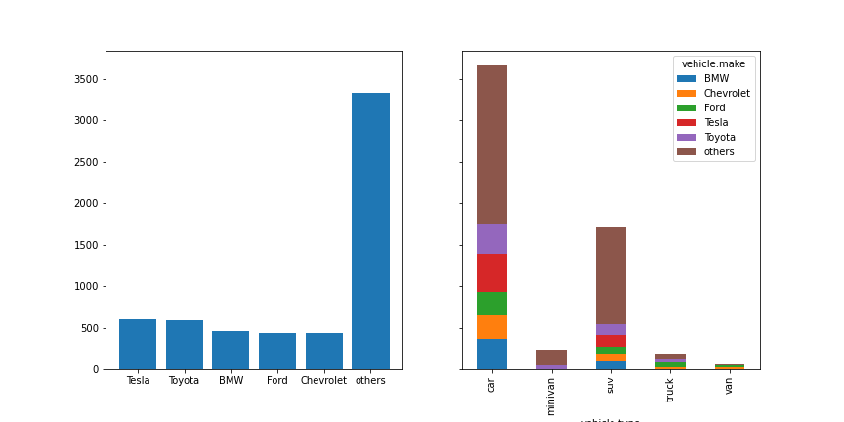
vehicle.make & by vehicle.type

Slide 7
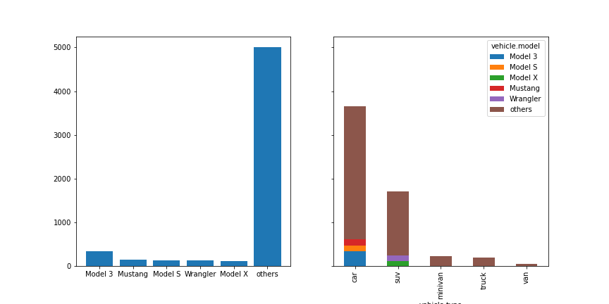
vehicle.model & by vehicle.type

Slide 8
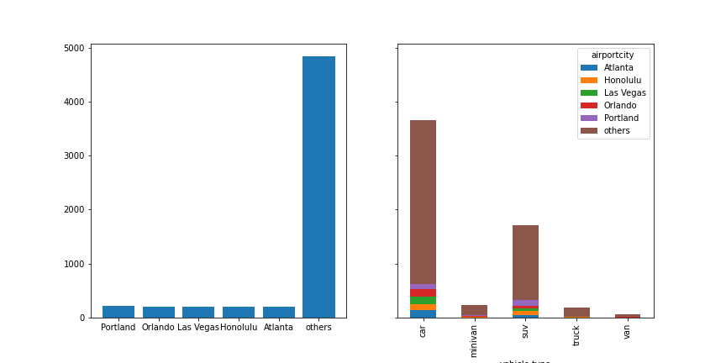
airportcity & by vehicle.type

